Slide 1
Lecture 1
Analyzing Risk in the Enterprise

Slide 2
Course Overview
Syllabus
Blackboard Website
Software Environment
Virtual Lab

Slide 3
Module 1 Study Guide and Deliverables
Topics: | Lectures 1: Introduction to Enterprise Risk Analytics Lectures 2: Analyzing Risk in the Enterprise
Readings: | Lectures 1 and 2 online content
Discussions: | Module 1 Discussion: Introduce Yourself (non-graded)
Assignments: | Assignment 1: Individual Assignment covering Lecture 1 and Lecture 2.
Assessments: | Quiz 1

Slide 4
Learning Objectives
After you complete this lecture, you will be familiar with the following concepts:
Definition of uncertainty and risk
Risk analysis and risk analytics
Methods of risk analysis
Simulation as a risk analysis tool
Advantages and disadvantages of simulation
Past, present, and future of simulation
Types of simulation software
Components of a simulation study and steps of conducting a simulation study

Slide 5
What is Uncertainty and Risk?
In AD571 Business Analytics Foundations, in many applications you have assumed that the world is certain and there is no uncertainty in the decision-making process. However, uncertainty is in the heart of many business problems and a key aspect of solving business problems is to deal with uncertainty appropriately. Uncertainty is defined as the imperfect knowledge of what will happen in the future. There are many sources of uncertainty that may appear in various business situations:
Demands for products
Times between arrivals to a bank/store
Stock price returns
Changes in interest rates
Changes in exchange rates
A company's market share for a particular product

Slide 6
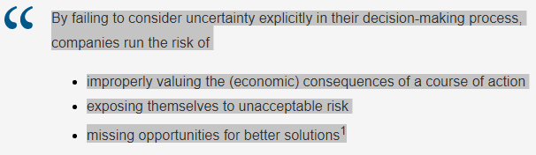
What is Uncertainty and Risk?
At times, uncertainty can be reduced or eliminated. For instance, standardization of work process can reduce the variation of the output. Similarly, mistake proofing can be utilized to eliminate the chance of a defect in a process. Once uncertainty is determined to exist at a certain level, companies should take action to determine its potential effect on the organization.

Slide 7
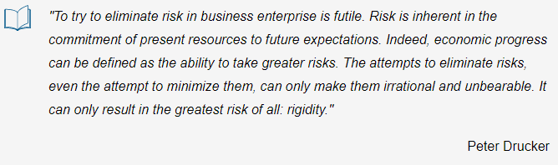
What is Uncertainty and Risk?
Therefore, decisions made on the basis of uncertain information involve risk. In this course, we define "risk as the likelihood of an undesirable outcome."² Hence, "risk implies a potential for loss"³ and it is the interest of companies to analyze and manage risk to have full control on their decision-making process. It is important to note that by analyzing risk, companies not only avoid loss but also discover opportunities and increase their competitiveness in the marketplace.

Slide 8
What is Uncertainty and Risk?
As Peter Drucker, who has been described as the founder of modern management, notes it is impossible to eliminate risk in a business environment. Risk is inherent in business processes. Therefore, the best we can do is to try to analyze and manage the risk. The more information we gain about how much we are exposed to risk, the more informed decisions we take in the management of the enterprise. Our goal in this class is to learn how to properly analyze risk and make better decisions for the future of the enterprise.
"Risk is usually assessed by evaluating the probability that the outcome will occur along with the severity of the outcome. For instance, an investment that has a high probability of losing money is riskier than an investment with a lower probability of losing money. Along the same lines, an investment that may result in $10 million loss is riskier than one that might result in only a $10,000 loss."⁴

Slide 9
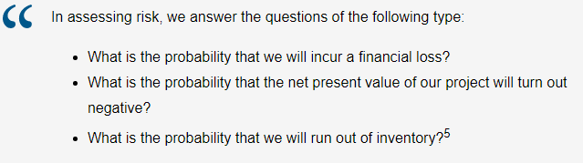
What is Uncertainty and Risk?

Slide 10
Risk Analysis and Risk Analytics
"Risk Analysis is an approach for developing a comprehensive understanding and awareness of risk associated with a particular variable of interest.^{"6} The following scenario illustrates the concept of risk analysis:
Example:
The executives of a food company must decide whether to launch a new packaged cereal. They have come to the conclusion that five factors are determining variables: advertising and promotion expense, total cereal market, share of market for this product, operating costs, and new capital investment. On the basis of the "most likely" estimate for each of these variables, the picture looks very bright – a healthy 30% return, indicating a significantly positive expected net present value. This future, however, depends on each of the "most likely" estimates coming true in the actual case. If each of these "educated guesses" has, for example, a 60% chance of being correct, there is only an 8% chance that all five will be correct (0.60 × 0.60 × 0 .60 × 0.60 × 0.60) if the factors are assumed to be independent. So, the "expected" return, or present value measure, is actually dependent on a rather unlikely coincidence. The decision maker needs to know a great deal more about the other values used to make each of the five estimates and about what he stands to gain or lose from various combinations of these values.
Source: David B. Hertz and Howard Thomas, Risk Analysis and Its Applications, Chichester, UK: John Wiley & Sons, Ltd., 1983.

Slide 11
Risk Analysis and Risk Analytics
"Thus, risk analysis seeks to examine the impact of uncertainty in the estimates and their potential interaction with one another on the output variable of interest."7 In this course, we will learn about risk analysis in the presence of (big) data – hence the phrase "risk analytics."
It is tempting to use the most likely value (or expected value) to model an uncertain quantity (as illustrated in the cereal example above). However, using the expected values for uncertain variables tells nothing about the variability of the performance measure that we base our decisions on.
Example:⁸
Suppose a $1,000 investment is expected to return $10,000 in two years. Would you invest if
the equiprobable outcomes could range from $9,000 to $11,000?
the equiprobable outcomes could range from -$30,000 to $50,000?
Although these two alternatives produce the same expected return ((9,000 +11,000)/2 = $10,000 and (-$30,000 + $50,000)/2 = $10,000) in the end, they carry different levels of risk. Apparently, the second alternative is more risky than the first alternative as it involves losing money (in the amount of $30,000!).

Slide 12
Risk Analysis and Risk Analytics
"Therefore, even if we can determine the expected outcome of a decision, it is equally important if not more to consider the risk involved in the decision."9 By proactively analyzing and managing risk, companies can make better decisions that add value.
We will examine the impact of uncertainty in the decision-making process of various enterprises. We will see several examples, where uncertainty is inherent and hence risk analysis is crucial:
Outsourcing
New product development
Single-period purchase decision
Exchange-rate risk
Marketing a new product

Slide 13
Methods of Risk Analysis¹⁰
There are three common methods used to analyze risk in a corporate environment:
Best Case/Worst Case Analysis
What-If Analysis
Simulation
Best Case/Worst Case Analysis: Best-case analysis uses the most optimistic value for each uncertain input in the model. Worst-case analysis, on the other hand, uses the most pessimistic value for each uncertain input in the model. There is a middle-way in between which is called base-case analysis. Base-case analysis uses the most likely value for each uncertain input. It is the most widely used approach by the managers; however, it leads to a pitfall called flaw of averages. Figure 1.1 illustrates this approach.

Slide 14
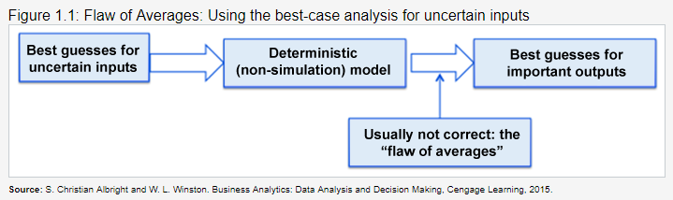
Methods of Risk Analysis¹⁰
Best case/worst case analysis is easy to do but it does not tell us anything about the distribution of possible outcomes within the best-case and worst-case limits. For instance, in Figure 1.2 we see four different distributions that the possible outcomes may belong to and each of these distributions are quite different from each other. Therefore, the likelihoods of the different outcomes between the worst-case and the best-case limits in each graph are different from each other. It is important for us to know the likelihood values because they are what we base our decisions on. Another disadvantage of this method is that it does not tell us how likely the worst outcome or the best outcome will happen.

Slide 15
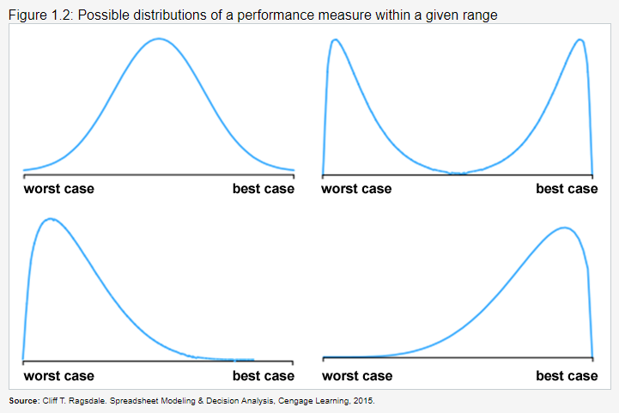
Methods of Risk Analysis¹⁰

Slide 16
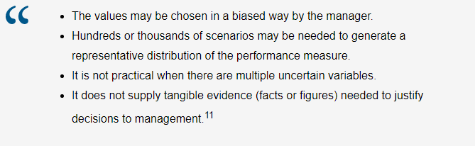
Methods of Risk Analysis¹⁰
What-If Analysis: What-if analysis uses several values for uncertain inputs including the most optimistic, most pessimistic, and most likely values and sees what happens. This is easy to do with spreadsheets; however, it has the following drawbacks:

Slide 17
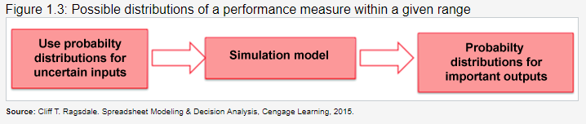
Methods of Risk Analysis¹⁰
Simulation: Simulation resembles automated what-if analysis. It uses probability distributions (such as the normal distribution) to provide a complete forecast of each of the major uncertainties faced in a decision-making process. "Probability distributions provide a complete description of our beliefs about uncertainty, including both the central tendency (the most likely outcome) and the variability (how much the actual outcome might differ from the most likely)."¹² Therefore, values for uncertain inputs are selected in an unbiased manner.
During a simulation study, the computer generates hundreds (or thousands) of scenarios and then calculates the consequence (i.e., profit) accruing that scenario. You can think of this performing the what-if analysis hundreds (or thousands) times with different values assigned to each uncertain input each time. Therefore, indeed when we execute a simulation, we obtain another probability distribution characterizing all the possible consequences of a particular course of action and their relative likelihoods. We then analyze the results of the simulation (i.e., simulation output) to better understand the behavior of the performance measure that we are interested in. This allows us to make decisions using solid empirical evidence. Figure 1.3 illustrates the simulation approach for risk analysis.

Slide 18
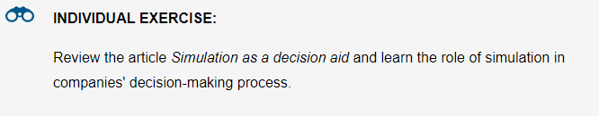
Methods of Risk Analysis¹⁰
It is important to note that the type of simulation that we have described above is called a stochastic (probabilistic) simulation, which incorporates uncertainty explicitly into the decision-making process. This type of simulation is also called Monte Carlo simulation and it uses probability distributions to represent uncertain inputs. The article “Simulation as a decision aid” discusses other simulation types. In this class, as our goal is to analyze risk, therefore we will be covering stochastic simulations. From now on, the word "simulation" will refer to "stochastic simulation".

Slide 19
Simulation as a Risk Analysis Tool – An Example¹³
In this section, our goal is to understand how simulation can be useful in a corporate decision-making process, where there are several uncertainties to consider. In particular, we will compare the approach of using simulation to analyze risk to the approach of using best-case/worst case scenario and what-if analysis. To this end, we will use the following example:
Example:
Consider a company that is trying to decide whether or not to continue a product line for the next quarter. Continuing the line would cost the company $500,000 in fixed costs (i.e., by dropping the line, the company would save $500,000 over current costs, not including the variable costs associated with making each individual unit of product). Each unit of product sells for $10 and costs $5 to make (i.e., once production is up and running, each additional unit costs an additional $5 to actually produce).
The company faces two major uncertainties involving the likely sales of the product in the upcoming quarter. First, a current client is considering making a major purchase of the product. Specifically, the client is considering the purchase of 50,000 units. Because of the size of the order, the company will offer to sell the product to the major client at a discount, specifically $9 per unit.
The client wants the same vendor for the entire purchase but there are competitors able and willing to provide the same product. Because of this competition, it is unclear whether the company will get the contract (assuming of course it continues the product line). Unfortunately, the company will have to make the decision of whether or not to continue the product line before knowing whether or not it will receive the major contract. The company believes that its chances of winning the contract, given that the client is a current customer, however, are better than fifty-fifty.
Second, there is uncertainty as to the general level of sales apart from the single major purchase. Since the company has been selling the product for years, there are ample data available on sales in previous quarters. Based on these data and an analysis of the market, the company's best guess is that it will sell 75,000 units if it chooses to continue the product, not including the major purchase.
Source: Carraway, R. L, Analyzing Uncertainty: Probability Distributions and Simulation, 2005.

Slide 20
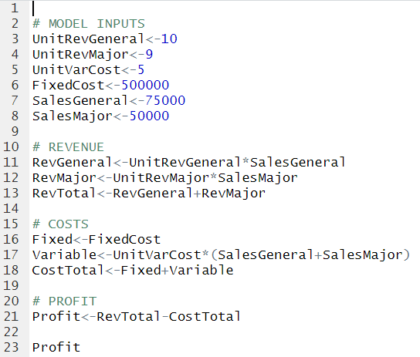
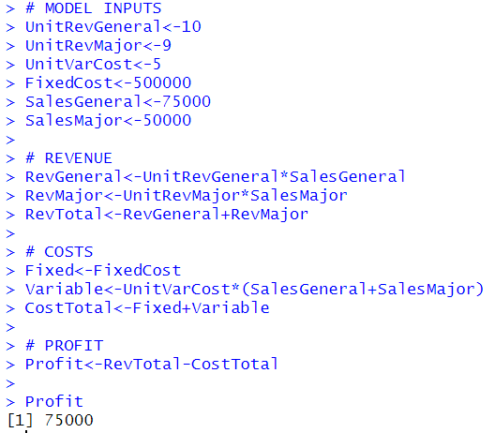
Simulation as a Risk Analysis Tool – An Example¹³
Scenario 1: "Assuming that the company gets the major contract (the best-guess) and that sales are at best-guess level, what is the profit that the company gets under this scenario?"¹⁴
Let us first build an R model that will calculate the profit under different scenarios. Figure 1.4 shows the code and results of running said code. Under this scenario, we obtain a profit of $75,000! Is it good enough?
Figure 1.4

Slide 21
Simulation as a Risk Analysis Tool – An Example¹³
Above, we compute the total revenue from the general public as the revenue per unit the number of units sold, and use the same formula to compute the revenue generated from the major sale.
We compute the total revenue by adding the revenue from the public to the revenue from the major sale.
We compute their total variable costs by multiplying the cost to make each unit by the total number of units they would make (combined units sold to the public and for the major sale). We add this to the fixed costs to determine total costs.
Finally, we compute profit by subtracting total costs from total revenue.

Slide 22
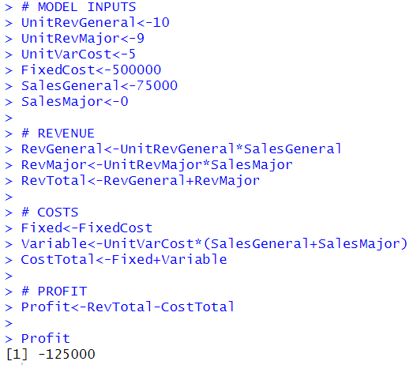
Simulation as a Risk Analysis Tool – An Example¹³
Scenario 2: What if the major purchase does not materialize? Figure 1.5 shows the resulting profit. Notice that we only changed the value of SalesMajor from 50,000 to 0. This time, we observe a negative profit of $125,000 so the company is losing money! "Clearly, whether the company gets the major purchase or not does a huge impact on the decision of whether it should continue the product line."¹⁵
Figure 1.5

Slide 23
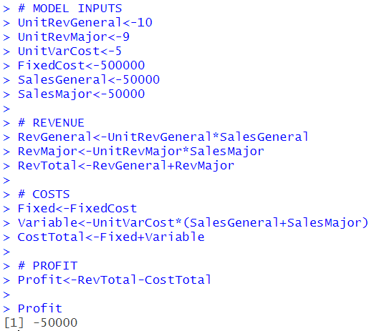
Simulation as a Risk Analysis Tool – An Example¹³
Scenario 3: One important thing to notice here is that 75,000-unit general sales is the company's best guess. The real sales could deviate from this number. Suppose that the sales could be as few as 50,000 units or as many as 110,000 units. Now, let us assume that the company gets the major purchase and sells only 50,000 units on the general market. Figure 1.6 shows the resulting profit. Notice that we changed SalesGeneral from 75,000 to 50,000 in comparison to what we have in Figure 1.4. We observe a negative profit of $50,000. So, even with the major contract, the company may lose money!
Figure 1.6

Slide 24
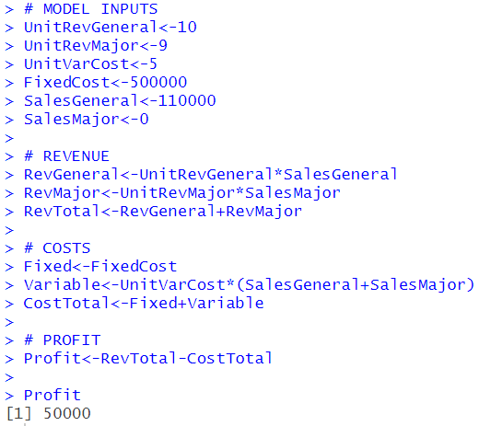
Simulation as a Risk Analysis Tool – An Example¹³
Scenario 4: Now let us assume that the company cannot get the major contract but sells 110,000 units in the general market. The resulting spreadsheet is shown in Figure 1.7. Notice that we changed SalesGeneral to 110,000 and SalesMajor to 0. This time we observe that the company makes money in the amount of $50,000 (even though it was not able to land the major contract).
Figure 1.7

Slide 25
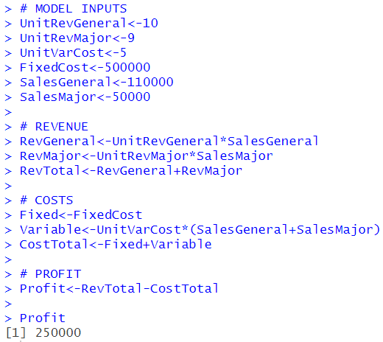
Simulation as a Risk Analysis Tool – An Example¹³
Scenario 5: Now let us look at the most optimistic case where the company gets the major contract and sells 110,000 units in the general market. The resulting spreadsheet is shown in Figure 1.8. This time we changed SalesGeneral to 110,000 and SalesMajor to 50,000. We observe that this optimistic scenario results in a profit of $250,000!
Figure 1.8

Slide 26
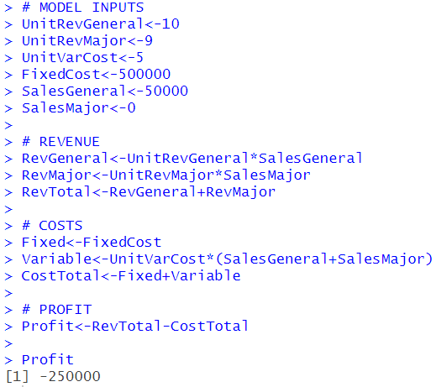
Simulation as a Risk Analysis Tool – An Example¹³
Scenario 6: Finally, let us look at the most pessimistic case where the company does not get the major contract and sells only 50,000 units in the general market. The resulting scenario is shown in Figure 1.9. This time we changed the value of SalesGeneral to 50,000 and SalesMajor to 0. We observe that if the worst-case scenario occurs, the company may lose up to $250,000!
Figure 1.9

Slide 27
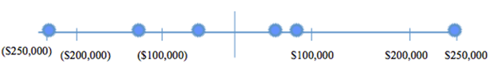
Simulation as a Risk Analysis Tool – An Example¹³
Table 1 summarizes the results of each scenario we have considered. As it is clearly seen from the table, the company can lose up to $250,000 and can make up to $250,000 under different scenarios.
Scenario # | Major Purchase Sales | General Sales | Profit
Scenario 6 | 0 | 50,000 | ($250,000)
Scenario 2 | 0 | 75,000 | ($125,000)
Scenario 3 | 50,000 | 50,000 | ($50,000)
Scenario 4 | 0 | 110,000 | $50,000
Scenario 1 | 50,000 | 75,000 | $75,000
Scenario 5 | 50,000 | 110,000 | $250,000
Table 1
We can also summarize these scenarios graphically as:
Figure 1.10

Slide 28
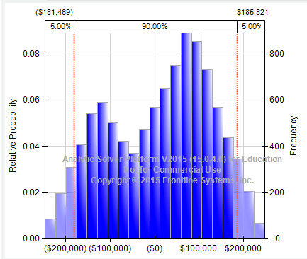
Simulation as a Risk Analysis Tool – An Example¹³
We can continue adding different scenarios and see how each scenario will result. However, individual scenarios do not provide any intuition about how likely we observe a particular scenario. For instance, we calculated that in the worst-case, we can lose up to $250,000. But how likely is that? With 50% chance? 10% chance? or 5% chance?
Simulation will answer this question for us. With the help of simulation, we will see the entire range of possible outcomes with their likelihoods of happening. "This probability distribution of the consequences is generally referred as the risk profile."¹⁶
Figure 1.11 presents the risk profile we would obtain if we were to simulate this problem. Right now do not worry about how we perform the simulation. We will learn how to conduct a simulation study in detail in the coming modules.
In Figure 1.11, the horizontal axis presents the possible outcomes for profit and the vertical axis presents the corresponding likelihoods (frequencies) of these outcomes. Using this graph, we can easily answer questions such as
What is the probability of making money?
What is the probability of losing money?
What is the probability of making more than $100,000? $ 200,000?
What is the probability of making money in the range $100,000-$200,000?
Figure 1.11

Slide 29
The Evolution of Simulation
In this section we will talk about the advantages and disadvantages of simulation; past, present, and future of simulation as well as simulation software available on the shelf.
Advantages of simulation
Simulation has been one of the most widely used tools to analyze risk in the corporate world due to the following reasons:
"It provides the flexibility to model things as they are:"¹⁷ Simulation is an alternative method to mathematical (analytical) methods used to model a system's operation. Analytical models give many insights about the system being studied. However, they require us to make many simplifying assumptions and approximations for the analytical model to work. Simulation is free of assumptions and approximations and it allows us to model the system as it is.
"It allows uncertainty and nonstationarity in modeling:"¹⁸ Simulation allows us to incorporate the uncertainties inherent in a system into our model easily. Furthermore, it allows us to model the nonstationary systems easily.
Easy to understand: Simulation models are easy to follow and comprehend in comparison to the analytical models.
Used to model complex systems that would be impossible to deal with analytically: If your system is simple enough, the use of traditional mathematical models such as linear programming and sensitivity analysis is a good way to model this system. However, complex models can seldom be represented by a simple analytical model. In this case, simulation is the only tool to use to model a complex system.
Allows one to experiment with the real system without disturbing the operations of the real system: For most business processes, experimenting with the real system is not feasible and it may even lead to disastrous outcomes such as the large financial losses. Simulation is a very convenient tool to experiment with a system and see how changes may affect the outcome without interfering with the real system.
Disadvantages of simulation
Although it is a very powerful tool, simulation is not without disadvantages:
Does not provide exact answers, only estimates: All analytical models provide exact answers to the questions under study such as how much money we can make, how much money we can lose, and so on. With a simulation model, this is almost impossible. At the end of a simulation, by the very nature of simulation, we obtain an estimate of the outcome under study.
Requires extensive use of statistical techniques: But this is made simple with the use of software for simulation. Those software do most of the work including running the simulation and providing the corresponding statistics of the simulation outcome. Therefore, with the advent of simulation software, you do not need to be an expert in statistics anymore.

Slide 30
Past, Present, and Future of Simulation¹⁹
Now let us review how the use of simulation has evolved over the years.
The early years (1950s-1960s):
Very expensive, specialized tool to use (processing cost as high as $1000/hour)
Mostly in FORTRAN – a general purpose programming language
The formative years (1970s – early 1980s):
Value of simulation widely recognized.
The recent past (late 1980s – 1990s):
Wider acceptance across more areas
Still mostly in large firms
The present:
Proliferating into smaller firms
Becoming a standard tool
Being used earlier in the design phase
The future:
Specialized "templates" for industries and firms
Automated statistical design and analysis
Networked sharing of data in real time
Integration with other applications

Slide 31
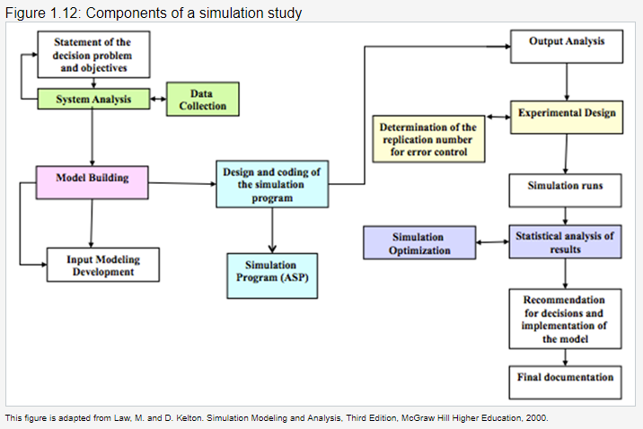
Components of a Simulation Study

Slide 32
Components of a Simulation Study
A typical simulation study starts with the statement of the decision problem and the objectives of the study. Then, we analyze the system under study and collect the data that is needed during the simulation. We then build the simulation model for the problem, which may require the design and coding of a simulation program. In this course, as a simulation program we will use R Studio.
The model-building phase and input development phase go hand-by-hand. In the input development phase, the goal is to identify the probability distributions that will represent the uncertain inputs of the model. This is indeed the most difficult phase of a simulation; it will be covered in Lectures 3 and 5.
After building the model and identifying the probability distributions to run the simulation, we next identify the outputs that we would like to monitor during the simulation. Example outputs are profit and net present value of a project.
Before running the simulation, we need to determine how many replications (trials) of simulation we will need to obtain a good (smaller error) estimate of the simulation outputs of interest. This topic will be covered in Lecture 4.
Finally, we run the simulation and analyze the results (if needed we can perform simulation optimization and may be other more general stochastic optimization tools, which will be discussed in Lectures 7 and 8). We recommend the decisions and details about how to implement our model and we provide a final documentation describing the details of the model.

Slide 33
Components of a Simulation Study
Now we summarize the stages of conducting a simulation study in 5 steps (assuming that we have already identified the problem, analyzed the system and obtained the data):
Step 1: Start with the deterministic model and construct a spreadsheet model that relates inputs to the output measures such as cost, net present value, profit etc.
Step 2: Identify inputs that are uncertain and identify probability distributions to represent those inputs (this is called "input modeling" in the language of simulation). We represent the uncertain inputs with probability distributions in a simulation model. A probability distribution indicates the possible values of an uncertain input and the probabilities of these values. The simulation model will draw values from this probability distribution and hence represent the uncertainty in the input. This will be clear in Lecture 2. Choosing the appropriate probability distribution is not an easy question to answer. We will study it in Lectures 3 and 5.
Step 3: Select one or more outputs to record over the simulation trials.
Step 4: Execute the simulation for a specified number of trials (repetitions).
Step 5: Analyze the outputs and interpret the implications in the decision-making process.
Source: Camm et al., Essentials of Business Analytics, 2015, Cengage Learning, pp. 526

Slide 34
Components of a Simulation Study
Example:²⁰
Suppose that an automobile manufacturer is planning to develop and market a new model car. The company is ultimately interested in the net present value (NPV) of the cash flows from this car over the next 10 years. However, there are many uncertainties surrounding this car, including the yearly customer demands for it, the cost of developing it, and others.
Building a simulation model for this problem involves choosing probability distributions for the uncertain inputs and seeing how the NPV changes as the uncertain inputs vary (Step 2). Each different set of values for the uncertain inputs is a scenario. By performing several trials, simulation allows the company to see many scenarios, each leading to a particular NPV (Steps 3 and 4). In the end, the company sees a whole distribution of NPVs, not a single number. In particular, the company sees what the average NPV will be as well as the best-case and the worst-case results. The company can also calculate the probability that the NPV will be smaller than or greater than a specific value. All these measures provide greater insight into the risk associated with a given decision. Keep in mind that only providing a distribution of an output may not be enough to drive a decision. A good risk analysis should drive actionable suggestions, which are tailored to the organization’s risk aversion.

Slide 35
Lecture 1 Footnotes
¹ Evans, J. R., Business Analytics: Methods, Models, and Decisions, 2e, 2016, Pearson Education, Inc., pp. 344-345. ² Ragsdale, C. T., Spreadsheet Modeling & Decision Analysis: A Practical Introduction to Business Analytics, 7e, Cengage Learning, p. 619. ³ Evans, J. R., Business Analytics: Methods, Models, and Decisions, 2e, 2016, Pearson Education, Inc., p. 379. ⁴ Ragsdale, C. T., Spreadsheet Modeling & Decision Analysis: A Practical Introduction to Business Analytics, 7e, Cengage Learning, p. 619. ⁵ Ragsdale, C. T., Spreadsheet Modeling & Decision Analysis: A Practical Introduction to Business Analytics, 7e, Cengage Learning, p. 619.
⁶ Ragsdale, C. T., Spreadsheet Modeling & Decision Analysis: A Practical Introduction to Business Analytics, 7e, Cengage Learning, p. 619. ⁷ Ragsdale, C. T., Spreadsheet Modeling & Decision Analysis: A Practical Introduction to Business Analytics, 7e, Cengage Learning, p. 619. ⁸ Evans, J. R., Business Analytics: Methods, Models, and Decisions, 2e, 2016, Pearson Education, Inc., p. 379. ⁹ Evans, J. R., Business Analytics: Methods, Models, and Decisions, 2e, 2016, Pearson Education, Inc., p. 379.
¹⁰ Evans, J. R., Business Analytics: Methods, Models, and Decisions, 2e, 2016, Pearson Education, Inc., p. 380. ¹¹ Ragsdale, C. T., Spreadsheet Modeling & Decision Analysis: A Practical Introduction to Business Analytics, 7e, Cengage Learning, Chapter 12 section '12.3: Methods of Risk Analysis' pp. 622. ¹² Evans, J. R., Business Analytics: Methods, Models, and Decisions, 2e, 2016, Pearson Education, Inc., pp. 344-345.
¹³ Evans, J. R., Business Analytics: Methods, Models, and Decisions, 2e, 2016, Pearson Education, Inc., p. 364. ¹⁴ Carraway, R. L, Analyzing Uncertainty: Probability Distributions and Simulation, 2005, Darden Business Publishing, University of Virginia. ¹⁵ Carraway, R. L, Analyzing Uncertainty: Probability Distributions and Simulation, 2005, Darden Business Publishing, University of Virginia. ¹⁶ Evans, J. R., Business Analytics: Methods, Models, and Decisions, 2e, 2016, Pearson Education, Inc., pp. 344-345.
¹⁷ Kelton et al. Simulation with Arena. 4th edition, Chapter 1, 2008. ¹⁸ Kelton et al. Simulation with Arena. 4th edition, Chapter 1, 2008. ¹⁹ Adapted from Kelton et al. Simulation with Arena. 4th edition, Chapter 1, 2008.
²⁰ Albright, S. C. and W. L. Winston, Business Analytics: Data Analysis and Decision Making, 2015, Cengage Learning, pp. 813–814.

Slide 36
Lecture 1 References
Carraway, R. L, Analyzing Uncertainty: Probability Distributions and Simulation, 2005, Darden Business Publishing, University of Virginia.
Evans, J. R., Business Analytics: Methods, Models, and Decisions, 2e, 2016, Pearson Education, Inc.
Camm et al., Essentials of Business Analytics, 2015, Cengage Learning.
Albright, S. C. and W. L. Winston, Business Analytics: Data Analysis and Decision Making, 2015, Cengage Learning.
Ragsdale, C. T., Spreadsheet Modeling & Decision Analysis: A Practical Introduction to Business Analytics, 7e, Cengage Learning.
Kelton et al. Simulation with Arena. 4th edition, Chapter 1, 2008

Slide 37
Lecture 1 Summary Questions
What is the relation between uncertainty and risk?
What is the importance of considering uncertainty in the decision making process of a company?
What are the methods used for analyzing risk? Discuss their pros and cons.
Why is Monte Carlo simulation the preferred method of risk analysis?
What is a “risk profile”? How does it help companies in their decision making process?
What are the components of a simulation study? Discuss the purpose of each component.
What are the five steps of running a Monte-Carlo simulation?

